Slide 1
ENSEMBL
PhytoPathDB
SolGenomics
TAIR
AraPort
Data ● Tools Provided ● USPs
Notes:
Ok, so Im going to spenf the next little section looking at some more databases, specifically

Slide 2
ENSEMBL
url: ensembl.org
Family of DBs
(Human is the flagship)
Assemblies ● Genes ● Annotations ● Expression ● Variants ● Comparative Genomics
Notes:
So the first database, or group of databases I want to tell you about are the ENSEMBL DBs.
This is a family of databases that are all more or less in the same format with similar tool structures. The whole ensembl project started as necessary way of annotating and disseminating the results from the human genome project.
The structure and tools are carried over to other groups of organisms and all the ensembl databases, let you get at Genome Assemblies, Gene models, Annotation, Gene Expression, Genetic variants like SNPs and INDELs and bigger comparisons across species and varieties.

Slide 3
ENSEMBL PLANTS
url: plants.ensembl.org
39 Plant Species
Notes:
So the ensembl plants database is one of the most interesting,
The principle view is the genome browser view, where you can see regions of the genome
This bit is the navigator, the blue line represents the chromosome and the red boxes are the extent of the genes etc in that regions – generally things called features.

Slide 4
ENSEMBL PLANTS
url: plants.ensembl.org
39 Plant Species
Notes:
The red outline in the navigator is expanded in this view
And in there are rows of different data types, and clicking on items in these rows gives you information and click throughs to different pages with info relevant to the thing you clicked..
ENSEMBL Has a lot of data types…

Slide 5
ENSEMBL PLANTS
url: plants.ensembl.org
Gene
trees – gene families, across plant kingdom, wider!
secondary structure
orthologs
GO terms
PO terms
genomic alignments
gene expression (outlinks)
variants
Transcript
exons
splice variants
cDNA
Protein
domain
prints, PFAM, PROSite, Panther, Gene3D
variants
Notes:
The views are at the three basic sequence type level.
For gene views you get things like gene sequence trees in the gene family across the species in ENSEMBL plants and pan-taxonomically. There are secondary structure predictions and lists of orthologs
There are GO terms, GO being the Gene Ontology which is a way of consistently adding functional and other annotation to genes. Similarly theres Plant Ontology which is a set of terms that consistently describe plant anatomy and development.
There are also genome level alignments – so you can view a regions similarity in other organisms and there are outlinks to other databases like gene expression databases;
Transcript views show all the sub structure of the transcripts, the splice variants,the exons and the cDNA and the sequence
And protein views show the protein sub structures, the domains etc with annotations of these from many other tools and databases, like the prints or PFAM – all of which are just ways of detecting protein domains.

Slide 6
ENSEMBL PLANTS
url: plants.ensembl.org
Tools
HMMER
BLAST
Notes:
The site also has a few tools in which you can upload your own sequence and work with it. Like HMMER for pfam domain,
BLAST for multiple sequence comparisons within the list of ENSEMBL plants species.

Slide 7
ENSEMBL PLANTS
url: plants.ensembl.org
Tools
BIOMART
BLAST
Notes:
Theres also biomart, that allows you to form very complex queries using clever filters and return lists of features matching your specs/

Slide 8
ENSEMBL FUNGI, BACTERIA, PROTISTS
url: fungi.ensembl.org, bacteria.ensembl.org, protists.ensembl.org
Gene
trees – gene families, across plant kingdom, wider!
secondary structure
orthologs
GO terms
PO terms
genomic alignments
gene expression (outlinks)
variants
Transcript
exons
splice variants
cDNA
Protein
domain
prints, PFAM, PROSite, Panther, Gene3D
variants
Notes:
That’s the general structure of all the ENSEMBL databases and they match that template more or less. Microbe genomes and data are kept in different sub databases. There are separate ones for fungi, bacteria and the protists
There are loads of genomes in here, especially in the bacteria one. But in the fungi and protists there are some tools missing like the hmmer , and lots of the comparaitve and annotation information. This is usually a direct result of the incompleteness of these genomes.

Slide 9
PhytoPath
url: phythopath.org
Based on ENSEMBL
Portal for Plant Pathogens
Literature Information,
disease progression info from PHI-BASE
Notes:
A related database based on the ENSEMBL browswer and data is PhytoPath. This contains plant patogen specific information. It adds value to the basic ENSEMBL information by incorporating information curated from the literature and by adding disease specific information from the PHI-BASE DB. Its powered by the biomart tool.

Slide 10
SolGenomics
url: solgenomics.net
Community Site for Solanaceae
Notes:
Moving away from the ENSEMBL databases here are some community plant databases – ones that are put together by and maintained by researchers active in those specific fields and that add value by being part of those communities.
The first is the sol genomics – specifically this adds value from community – so expert manual and not just automated annotation and gene assemblies.

Slide 11
SolGenomics
url: solgenomics.net
Tools
Biochemical pathways
Notes:
The site is again genome browser centric but beyond that
They have their own versions of the comparative genomics tools that we saw on ENSEMBL and some extra really cool tools. Like the biochemical pathways which you see here, the blobs are genes the diagrams are the pathways.

Slide 12
SolGenomics
url: solgenomics.net
Tools
CAPS experiment designer
VIGs tool
Alignment Analyser
Tree Browser
Notes:
They also have tools for designing CAPs assays, for VIGs experiments on the genomes in the database and alignment and tree visualisation tools for your uploaded data as well as loads of other stuff for Mapping, in silico PCR and some breeder tools.

Slide 13
TAIR
url: arabidopsis.org
Gold Standard DB for Arabidopsis
Data
Genes - Transcripts – Proteins - Genomes
GO / PO
Locus history
Markers
Array elements, expression, labs
Protocols, Publications
Seeds, Germplasm
Tools
Gbrowse
Synteny browser
Protein-Protein Interaction Browser
AraCyc Metabolic Pathways
BLAST & WU-BLAST
Pattern/Motif Finders
Expression / Array Clustering
Portals
Clone stocks
Education
Gene Expression
Gene Annotation
Metabolome
Mutant (Genetics)
Notes:
Ok, so TAIR – the Arabidopsis information resource is the original gold standard database for Arabidopsis. The site covers just one genome but there is a truck load of tools and annotations on the thing. Again its genome browswer centric but you can search on many types, including the history of the locus and Protocols and publications, which have all been added by dedicated curators.
Unique Tools include protein interaction browsers, Metabolic pathways and Motif finders.
The site organises these into Portals of related topics to aid the user some of which are also instructional
Funding for TAIR from NIH ran out a few years ago and ever since TAIR is a full subscription service, so you have to pay for it. Usually this is done on the lab level or institute level. But if you find that there are parts of it you can’t get at – you might need to subscribe.

Slide 14
AraPort
url: araport.org
Next-Gen Portal for Arabidopsis
Data
TAIR 10 Genes - Transcripts – Proteins - Genomes
Araport 11
Live community annotation
Tools
JBrowse
App Store
20+ apps
sequence tree views
search
phosphorylation
interactions
BLAST+
Notes:
So in response to the funding of TAIR going away, an update database was produced., this is araport and it starts with the most recent TAIR 10 genome release and builds a next generation infrastructure on it.
Theres a lot of clever future proof high-throughput software in the background but it presents a genome browser with a new annotation, including features for in browser genome annotation
Its main utility though is its app store feature – this is a structure that allows any external developer to add a tool that makes use of the data to do a specific job, there are about 20 on there at the moment and theyre pretty standard, the BLAST etc, and some more interesting ones like phosphorylation database stuff and some interaction data.
Araport is quite new and expanding so if you need something specific and it doesn’t exist you can get it added in

Slide 15
Genome Assembly and Annotation
Best Practices, Best Tools
Notes:
Ok. So in this section Im going to talk about Genome Assembly and Annotation and look at some of the tools we have to do that

Slide 16
Structure
AIM:
Help you develop a strategy for performing a genome assembly and assessing its quality
Theory
Sequence Types
Algorithm Basics
Assessing an Assembly
Tools
For Assembly
For Assessment
For Annotation
Notes:
The aim with this section will be to give you a bit of background and help you to come up with a first strategy for doing genome assembly
And to that end we’ll go over a bit of theory on the sequence types and have a look in a general and useful way at the basics of the algorithms – there wont be any hardcore computer science, and how to critically assess an assembly.
Then we’ll look at the tools for actually doing the assembly.

Slide 17
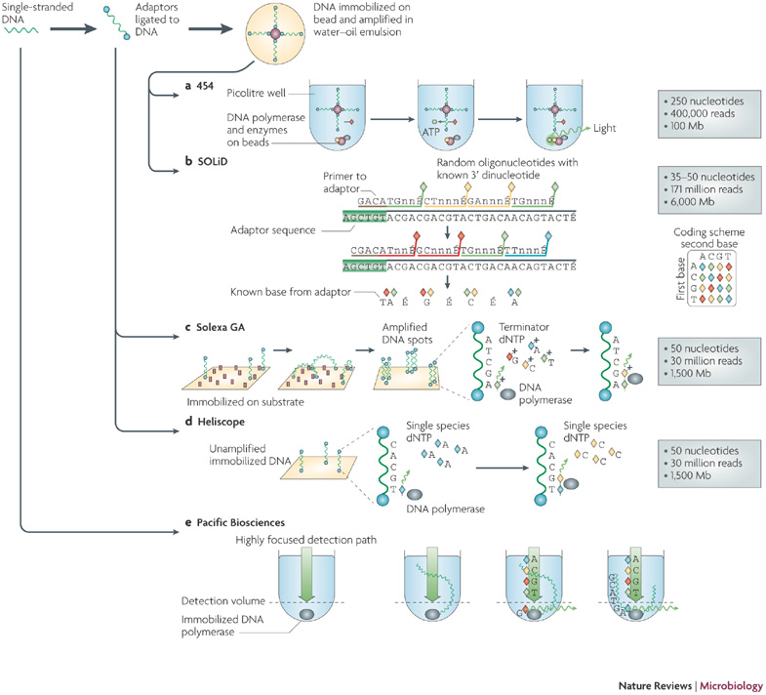
Sequencing
Two major kinds
- Illumina
- Pacific BioSciences
Illumina
Sequence by Synthesis
PacBio
Single Molecule Real Time
Notes:
Ok, so first things first, high throughput sequencing for genome assemlby. At the moment there are two main technologies that that get used. The first is Illumina sequencing by synthesis, this is the older technology and it works basically by using small primers bound to a slide that bind to the ends of DNA fragments that you wash over them. Then these fragments are amplified by PCR to make large clusters of the same sequence. To actually sequence you introduce terminator fluorescent dNTPs in cycles and measure the fluorescence that comes from each spot in each cycle, so you sequence by synthesising a complementary strand.
The other technology is Pacific BioSciences Single molecule system which is based on a slide with tiny zeptoliter holes in it and DNA polymerase tethered to the bottom. When DNA is introduced the polymerase startes to synthesise and incorporates the fluorephores which are recorded as it goes, to get high accuracy each molecule has to be read multiple times

Slide 18
Paired-end and Mate Paired Reads
Paired End
Read both ends of the molecule
Separated by ~ 500 bp
Mate Pair
Circularize long molecules (1-10kbp)
Shear into fragments then sequence
Notes:
The are different ways of preparing the DNA for sequencing that results in some extra information about reads. With Paired end and mate paired strategies then you get info about the distance between the reads. In Paired end you basically read both ends of a molecule that you more or less know the length of, these tend to be separated by about 500 bp in practice.
With Mate Pairs, the fragment is circularized and you cut out and sequence the two end parts, so you end up with a distance of about 10 kbp in practice. If the cutting goes wrong though, then you end up with the middle of the molecule and a shorter distance.
So the take home of this is, different preparations let you know the distance between reads in the original fragment.

Slide 19
Brief sequence comparison
 | Illumina | PacBio
Length | <300bp | <10kb
Reads per run | 25 – 400 million | ~50 thousand
accuracy | >99% | ~86%
Notes:
So there are some more practical differences, Illumina reads are much shorter, though that headline figure from PacBio is more like 5kb in practice. You do get many more reads from Illumina and much higher accuracy, but it isn’t cut and dried as to which you should use for every application, the decision will be very case dependent. These are the basic facts you should know though

Slide 20
The Assembly Problem
Rebuilding a shredded text
Rick Astley accidentally shreds the lyrics to his first album…
Never gonna give you up, never gonna let you down, Never gonna run around and desert you, Never gonna make you cry, never gonna say goodbye, Never gonna tell a lie and hurt you
Never gonna give
gonna give you up, never
never gonna let you down
never gonna
you down, Never gonna run
Never gonna
give you up, never
give you up, never gonna let you
let you down, Never
never gonna let you down,
down, Never gonna
How can he put them back together?
The fragments from all copies are mixed together
Some are identical
Notes:
OK, so onto the sequence assembly problem. Shotgun sequencing results in lots of fragments of a once linear string. So it gets likened to putting back together a text thats been through a shredder. So imagine that pop star Rick Astley accidentally dropped his lyrics in the shredder – he’d end up with loads of bits that looked like this, they’d be all mixed up and some would be identical to each other
How can he start to put them back together

Slide 21
Greedy Algorithm
Never gonna
Never gonna give
gonna give you up, never
never gonna
Never gonna give
never gonna let
Repeated sections make the proper assembly ambiguous
Notes:
Well the first thing is to use the overlaps in the fragments and try to rebuild the sequence, this brute force idea is a greedy algorithm, but it fails because our read length isn’t good enough – it contains those identical fragments and the repeats therefore make the real assembly hard to uncover

Slide 22
de Bruijn Graph
Make all ‘k’ length fragments
Network of possible directional links – from overlaps
Never gonna give
gonna give you up
Notes:
So the most popular solution to this is to use a data structure called a de Bruijn graph, in which we smash our reads into sub fragments and make a network or graph from the overlaps in the sub fragments

Slide 23
de Bruijn Graph Assembly
gonna run around
Never gonna give
never gonna run
gonna give you up
you up never gonna
never gonna let you down
down, Never gonna
Build Graph and simplify
Notes:
And assembly programs do this, they build the graph and draw all possible links, so it gets quite convoluted, so the next step is go on to simplify

Slide 24
de Bruijn Graph Assembly
never gonna run around
Never gonna give you up
You up never gonna
never gonna let you down
down, Never gonna
Build graph and simplify
Notes:
And simplification is – basically condense the long runs into contigs that can be output as an assembly
so you get some longer bits but not all the forks will be resolved, and you end up with equally likely alternative but different paths through the graph

Slide 25
Assembling a genome
1. Shear and sequence DNA
2. Make assembly graph from overlapped reads
AGCCTTAGACCTACAGGATGCGCGCACAGT
GATGCGCGCACAGTAGCCTTAGACT
3. Simplify assembly graph
4. Detangle graph with long reads, mate pairs and other links
Notes:
Ok, so that’s the tricky computer science over ! And from start to finish the process of genome assembly is like this: You get and shear your DNA, you make that assembly graph and solve and simplify it as best you can, then you bring in that extra information from paired ends and mate pairs to allow you to orient and order different fragments relative to each other.

Slide 26
Why are genomes hard to assemble?
Biological Problems
Polyploidy, heterozygosity
Repeats, repeats
Sequencing problems
Large genomes genome >>> reads
sequence read errors
3. Computational
Very large genomes
Complex repeat structure
Accuracy
What is correct assembly?
How do we tell?
Notes:
Genome assembly is a hard thing. For lots of reasons. Some of the difficulty can come from the biology, so instead of having on nice long linear molecule, like a single book, then you have polyploidy which is like having many copies of the book, that may be slightly different from each other. Also genomes are full of repeated sections so that messes up our programs, repeats are the biggest problem
Then there are sequencer based problems. Genomes are many times larger than the reads we can generate, so really we have dreadful resolution.
Computational problems can come from having very large genomes – you just need really large computers to handle the amount of information. And complex repeat structure means there are loads of bubbles in the graphs to resolve so time becomes an issue
And then when you’ve done all that, there’s the question of whether the output assembly is correct and how we tell - to which the short answer is no, it isn’t completely correct, though large parts of it may be and there are some sanity checks we can do to have confidence in what we’ve come up with

Slide 27
What you need for a good assembly
Coverage
Oversample
Read Length
Longer than repeats
Quality
Errors mess up overlaps
Notes:
In order to stand a good chance of getting a good assembly you need to try and ensure that you have a lot of coverage, so basically this is the number of times that you include a genome nucleotide into a read, the more the better and on the order of 30 times is a good starting point.
Then the longer the reads the better, you want reads that include the whole repeat but this isn’t always practicable.
And you also need to minimise the errors in the reads as these mess up calculations of overlaps
So you can see why you need to judge carefully with sequence types

Slide 28
Coverage
Times sampled
Some segments may not even be sequenced!
Notes:
Coverage needs to be paid attention to in particular, because coverage is not even. Random sampling means that in a genome of many millions of bases, then some regions may not get sequenced.
In this graph we have a contig and reads sampled from it and its clear that the random sampling results in some eventual bald spots in the coverage graph. You do need to get enough sequence to really oversample to ensure you get as much of the genom as you can

Slide 29
Read Length and Repeats
Times sampled
Assembly length increases with read length, especially when it passes the repeat length
Notes:
Read length is important, here we see the read length put into an assembly and the resulting measure of contig length increasing when the average repeat length in a particular genome is passed. That’s because the whole of the repeat is represented unambiguously and loops in graphs disappear so the region resolves much more easily

Slide 30
Scaffolding
Contigs end at
- coverage gaps
- errors
- repeat boundaries
Use paired end/mate information to place contigs relative to each other
- has gaps
Notes:
Contig extension ends for a number of reasons,
Where coverage has gaps you don’t know what comes next so you hit a literal dead end,
Errors in the reads result in dead ends too
And repeats make graph structures that you can’t traverse with the reads
The final step is scaffolding in which you do a kind of meta assembly of the contigs, you can use the links to put the assembly in order. For example if you know that one contig has reads in it that are 10 kbp from reads in another contig, yu can say that those two contigs must be that distance apart, so you might end up with some gaps, but you can complete the assembly more

Slide 31
Assembly Tools
Loads! Including but not limited to ..
SOAPdenovo, HyDA, ABySS, ALLPATHS-LG, Velvet, Celera, PacBio Corrected Reads, Mira, meraculous, Newbler, Ray, SGA, CLC Assembly Cell …
Notes:
Ok, so this problem hasn’t been solved in software by any means. Many projects have wanted to employ particular strategies so developed their own code, hence the many tens of tools of which these are a few

Slide 32
Assembly Tools
SOAPdenovo
Celera Assembler
Notes:
But I’ll discuss just two that make use of slightly different strategies and take in different sets of input. They’re both from two big genome assembly institutes, so they’ve been used in big projects. The first will be the short read assembler from BGI, SOAPdenovo – a flexible but complex tool and the second will be Celera from JCVI which was used in the Sanger read assembly of the human genome and can deal with mixed read types and prefers to assemble from the medium / longer reads as it doesn’t employ the full de bruijn graph, but just the overlap graph.

Slide 33
Short read assembly
SOAPdenovo
Get a big computer
Different specs for every genome and sequence data.
> 128Gb RAM for Pathogen genomes
> 1Tb for Plant genomes
Notes:
SOAPdenovo starts with the short reads, smashes them into the short kmers and builds the de bruijn graph, then it builds the contigs, but one behaviour to note is that it follows all paths without aggressively simplifying the bubbles, so it lists all paths as contigs, and you get all the potential genomes. Which is useful to retain heterozygosity, but also is impaired when you want get lots of kmers that come from errors. In fact lots of assemblers suffer from this, so its worth considering how to stop the problem of getting extraneous contigs.

Slide 34
PreProcessing
FASTQC plots quality scores and sequence metrics and allows development of filter thresholds for whole sequence sets
before
after
Notes:
An answer is to prepocess you sequence data – for example with fastqc. Basically it will draw boxplots of the distribution of quality scores in each position in each read, so the y axis here is the position in the read and, here’s a set before processing where the quality of the bases drops off fairly drastically as you go to the end. The right panel shows a better sequence set after throwing out the bad reads or bases.

Slide 35
PreProcessing
Trimmomatic uses a sliding window approach from the 5` end to identify low quality regions which are then trimmed from the 3` end. Reads < 36 bp are discarded
Notes:
A program like trimmomatic is something you can use to actually do the quality control, this will throw out poor or too small reads but also slice off sequencing adapters or poor quality sequence from the start or end of reads allowing you to retain and work with only the good bits.

Slide 36
Long read assembly
Celera Assembler
Notes:
Celera assembler is different, it uses an overlap graph of longer reads so is great for PacBio. Celera does some initial consistency and trimming steps before it does high quality overlaps, not exact overlaps like the de bruijn graph one, but mismatches are allowed, then there are error and contigging and scaffolding, the final build is a consensus sequence from the reads, so collapsing the differences in the overlapping parts of the reads into one final sequence.

Slide 37
Hybrid assembly
1. Map Illumina reads to PacBio reads to correct errors
2. Assemble
Notes:
So this makes it great for use with PacBio but those errors make the overlaps hard to compute so its possible to do a hybrid assembly with Illumina reads to correct the errors. By using and aligning the more accurate Illumina reads to the PacBio ones, you can get a consensus from the Illumina.

Slide 38
Assessing an assembly
N50
50 % of genome in contigs longer than the N50 contig
Massively Abused!!
Notes:
So once you’ve got a genome assembly you want to know how good it is. The basic metric for this is N50, which is a proxy for contig length distribution, with the idea that more, longer contigs is better. Its calculated by lining up the contigs in descending length until you pass the halfway point of the target genome (so you need to know a length for the genome). The length of the contig at that 50% point is the N50.
So this is ok, but its really abused, people do take it to be an absolute measure of assembly quality and obviously it’s a completely gameable figure. You could optimise for N50 and end up with junk in the actual sequences so I advise extreme scepticism. Use it in conjunction with estimates of contig quality.

Slide 39
Assessing an assembly
Visual Graph Inspection - Bandage
Allows easy visualisation of some graphs. Assess structure (and sanity) of the assembly
Notes:
There are ways to visually assess the final graph produced from some assemblers, this program– bandage - allows that. IT provides a set of tools that allow you to inspect and check various features of the assembly so you can sanity check it a high level

Slide 40
Assessing an assembly
Internal contig consistency
Align original reads to contigs.
Do they all align without breaks?
Is the distance between pairs consistent?
Is coverage as expected?
Savant Genome Browser
Notes:
A very common thing to do is to re-align the reads back to the contigs. A good assembly should have good back alignments with no gaps, with even coverage and with the distance between mate pairs as expected. You can easily identify collapsed repeats and misassembled regions by inspecting these features. A good genome browser like Savant, will help you view these properties, here we can see a massive gap in the contigs that shouldn’t be there

Slide 41
Assessing an assembly
Gene Content
Core Orthologues – are they all there?
BUSCO – identify and quantify completeness of core orthologues per clade in an assembly
Notes:
You can also assess gene content, there are systems like BUSCO and CEGMA that use libraries of core orthologues from different groups in the taxonomy that should be present in your assembly and can tell you how many and how complete these are, if you get a good assembly you’ll get more complete orthologue sets

Slide 42
RNA Seq
Best Practices, Best Tools
Notes:
Ok. So in this section Im going to talk about RNA seq – high throughput sequencing from RNA, not DNA and look at some of the tools we have to do that

Slide 43
Structure
AIM:
Help you develop a strategy for performing RNAseq and assembly and assessing analysis quality
Theory
Sequence Types
Algorithm Basics/ Tool Types
Assessing an Alignment/Assembly
Tools
For Alignment/Assembly
For Differential Expression
Notes:
The aim with this section will be to give you a bit of background and help you to come up with a first strategy for doing genome assembly
To start I’ll go over a bit of theory on the sequence types and have a look briefly at the basics of the techniques that we use
Then we’ll look at the tools for actually doing the alignments and assembly and working out differential expression.

Slide 44
Why RNA Seq?
Gene expression and differential expression
Alternative expression analysis
Transcript discovery and annotation
Allele specific expression
Relating to SNPs or mutations
Mutation discovery
Fusion detection
RNA editing
Notes:
Ok, So RNA seq is the most flexible approach I’ll talk about today, it has many uses. The main difference between this and genome seq or DNA seq is that this is potentially quantitative.
You can use it for gene expression and differential analysis, including alternative splicing detection and isoform expression. You can use it for SNP/Indel and allele specific expression patterns and for gene fusing and RNA editing.

Slide 45
The RNAseq Pipeline
RNA-seq reads (2 x 100 bp)
Read alignment
Transcript
Compilation
Gene
Identification
Expression Estimates
Raw sequence data
(.fastq files)
Reference genome
(.fa file)
Gene annotation
(.gtf file)
Visualisation
Inputs
Notes:
Ok, so this is a typical RNAseq workflow. The key things to note here are that its an involved workflow that often needs more initial info than in genome assembly/
You’d start off with your sequence, usually paired end reads and then once that is QC’d and you’re happy with the quality you can go on to do an alignment of the reads to a reference genome, this of course requires you have a genome sequence to align to. It is possible to do completely de novo transcript assembly if you don’t have that.
Then there’s compilation and assembly of the alignments or assembly into actual transcript models and annotation of those models.
And once you know what transcripts you can start to quantify

Slide 46
Alignment with Millions of Sequences
Computational cost
100’s of millions of reads
Oldstyle (Smith-Waterman) – Newstyle (Burrows Wheeler Transform, Suffix Trees)
Introns!
Spliced vs. unspliced alignments
Can I just align my data once using one approach and be done with it?
Unfortunately probably not
Notes:
So the crucial step is alignment to the reference. This is done with custom high throughput tools. We can’t do old-style blast alignments with 100s of millions of reads because of the large computational cost - those older algorithms don’t scale well up to data that size,
Newer programs based on structures called Burrows Wheeler Transfomr scale linearly so can handle this.
A significant issue is how to deal with introns, RNA doesn’t have them in the sequence so the read has to be split appropriately.
And as with all bioinformatics, there isn’t a magic button or solution that gives the right answer every time so you are going to be QC ing and comparing approaches throughout the process.

Slide 47
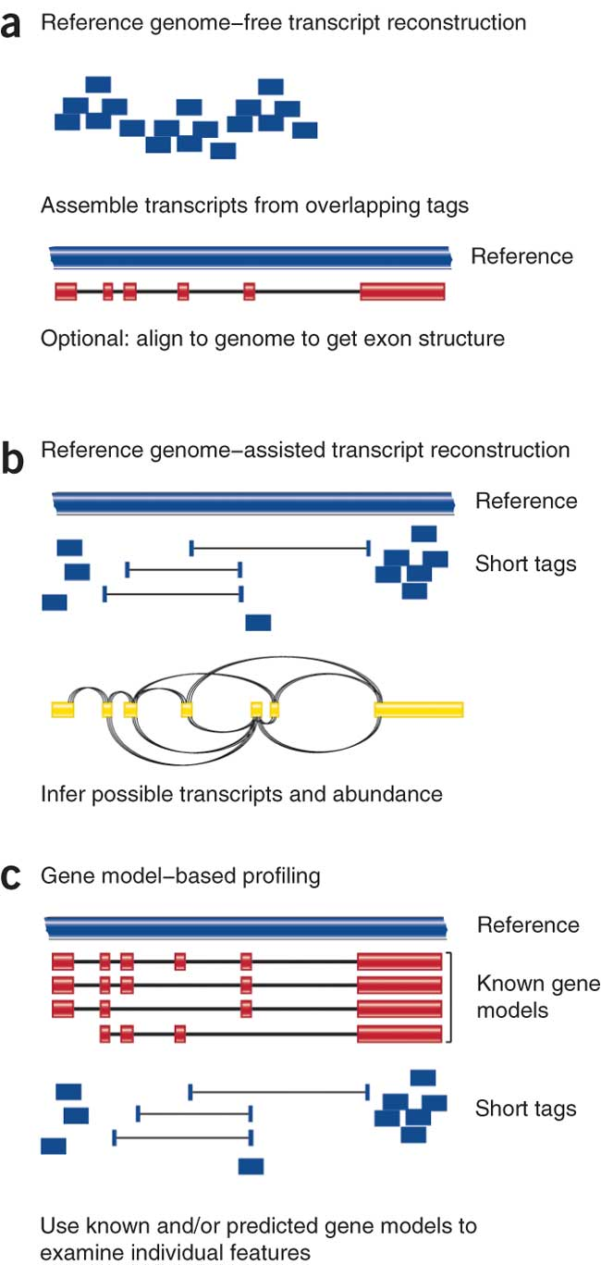
Alignment (mapping) strategies
De novo assembly
Align to transcriptome
Align to reference genome
Diagrams from Cloonan & Grimmond, Nature Methods 2010
Notes:
Which alignment and assembly strategy to take will depend on the application.
You’ll be best served with De novo assembly
If a reference genome does not exist for the species being studied
or If complex polymorphisms/mutations/haplotypes might be missed by comparing to the reference genome
Aligning to a transcriptome – so gene model or CDS seqeunce is best
If you have short reads (< 50bp)
Aligning to a reference genome is still generally a good idea In all other cases, but you may be advised to mix it up with a completely de novo assembly to help guard against errors in the reference genome
Each strategy involves different alignment/assembly tools

Slide 48
Alignment Tools
RNA
Bisulfite
DNA
microRNA
http://wwwdev.ebi.ac.uk/fg/hts_mappers/
Notes:
There are over a hundred next generation alignment tools, and I can’t possibly list or discuss them all. They each have specialisations for particular things and everyone has a different favourite for different reasons. The main thing is to find one that works for you and that you’ve shown creates sensible, verifiable output by a control experiment.
I will discuss some generally well used aligners though.

Slide 49
Splice Aware Aligners – Tophat/Bowtie
RNA-seq reads may span introns
Read X
Read Y
Exon 1
Exon 2
?
Read X
Map with Bowtie
Read Y
Exon 1
Reference
Exon 2
Read Y
Read X
Aligned Bin
Unaligned Bin
Notes:
So the main one I want to mention is the TopHat/Bowtie pair of tools that carry out Splice Aware alignments. Here’s how they work together.
The fragments being sequenced in RNA-seq represent mRNA and therefore the introns are removed
And as we are usually aligning these reads back to the reference genome so, unless your reads are short (<50bp) you need to be mindful of that
The first stage of alignment requires a reference genome, the program breaks reads into pieces, uses ‘bowtie’ aligner to first align these pieces. Anything that aligns well, like this blue read on the first exon is kept
Any read that has only a partial good match is sent to an unaligned bin for further consideration
Then extends alignments from these seeds and resolves exon edges (splice junctions)

Slide 50
Splice Aware Aligners - Tophat
X1
X2
X3
Read X
Read X
Unaligned Reads
X2
?
X1
X3
Exon 1
Reference
Exon 2
Collect Mapping Information for X1 and X3
Construct a Splice Library
Notes:
TopHat Then makes seed alignmets from the fragmet and unaligned information
Then it extends alignments from these seeds and resolves exon edges to construct a splice library. So the take home is that reads get cleverly split ofver potential introns to make splice variants

Slide 51
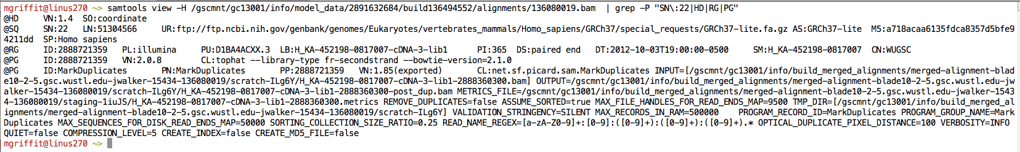
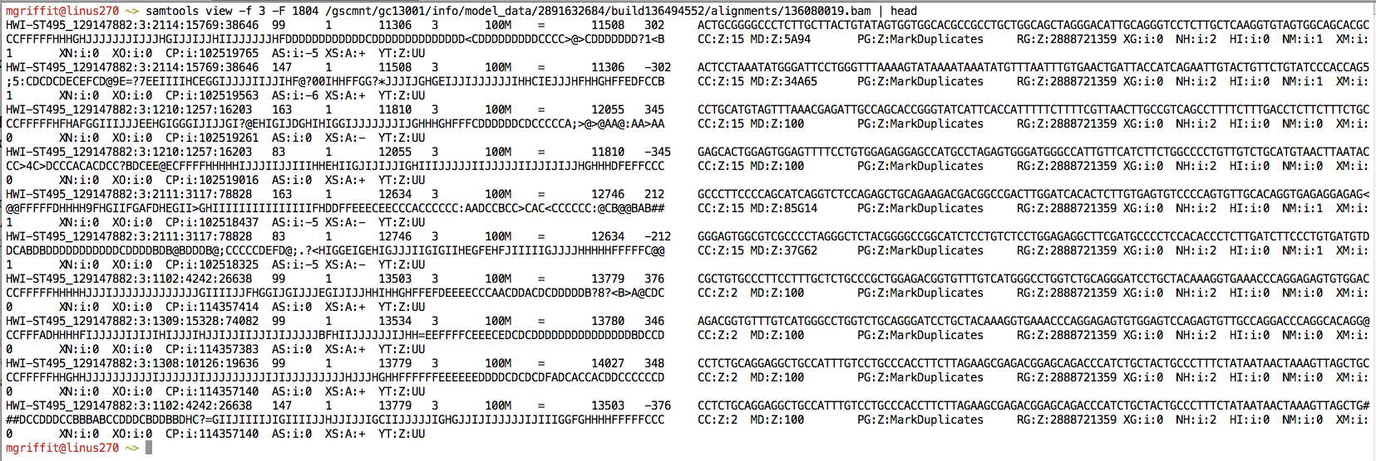
SAM/BAM
Example SAM/BAM header section (abbreviated)
Example SAM/BAM alignment section (only 10 alignments shown)
Notes:
When you’ve created an alignment, pretty much every program generates this output – this is SAM output and manipulating this is the key to working out whats going on with your alignments. You get one line for every read, so its not something you can do with from the file, rather you’ll want to visualise and summarise the alignments especially to do quality control of the alignments. The eventual transcript models you come up with are heavily dependent on the quality of the alignments, so they need to be good.

Slide 52
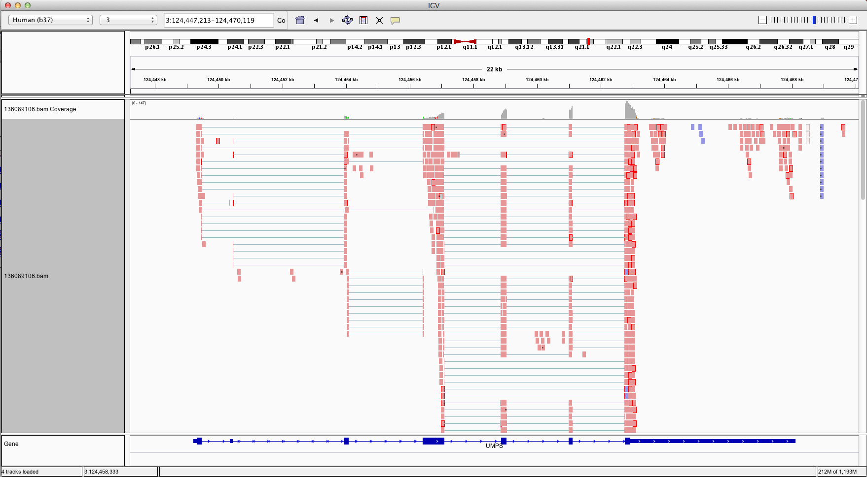
Visualizing Alignments
IGV
Ideogram
Coverage
pileup
Control pop-up info
Viewer position
Coverage
track
Coverage
scale
Single reads, not spliced
+ve
strand
-ve
strand
Reads track
Single reads, spliced
Gene track
Notes:
There are a few good genome browser tools that will help you see the alignments on the reference. The one here is IGV – integrated genomics viewer
It shows the reference as a single line atthe top of the window and the main block is the alignment from a SAM file. Each pink mark is a part of the read that is aligned and the blue thing at the bottom is the pre-existing gene model.
So you can tell how well the read model is supported by the alignment, how clear the alignment is, and generally start to get a feel for whats going on. These views are especially good when you want to inspect single candidate genes later in the analysis

Slide 53
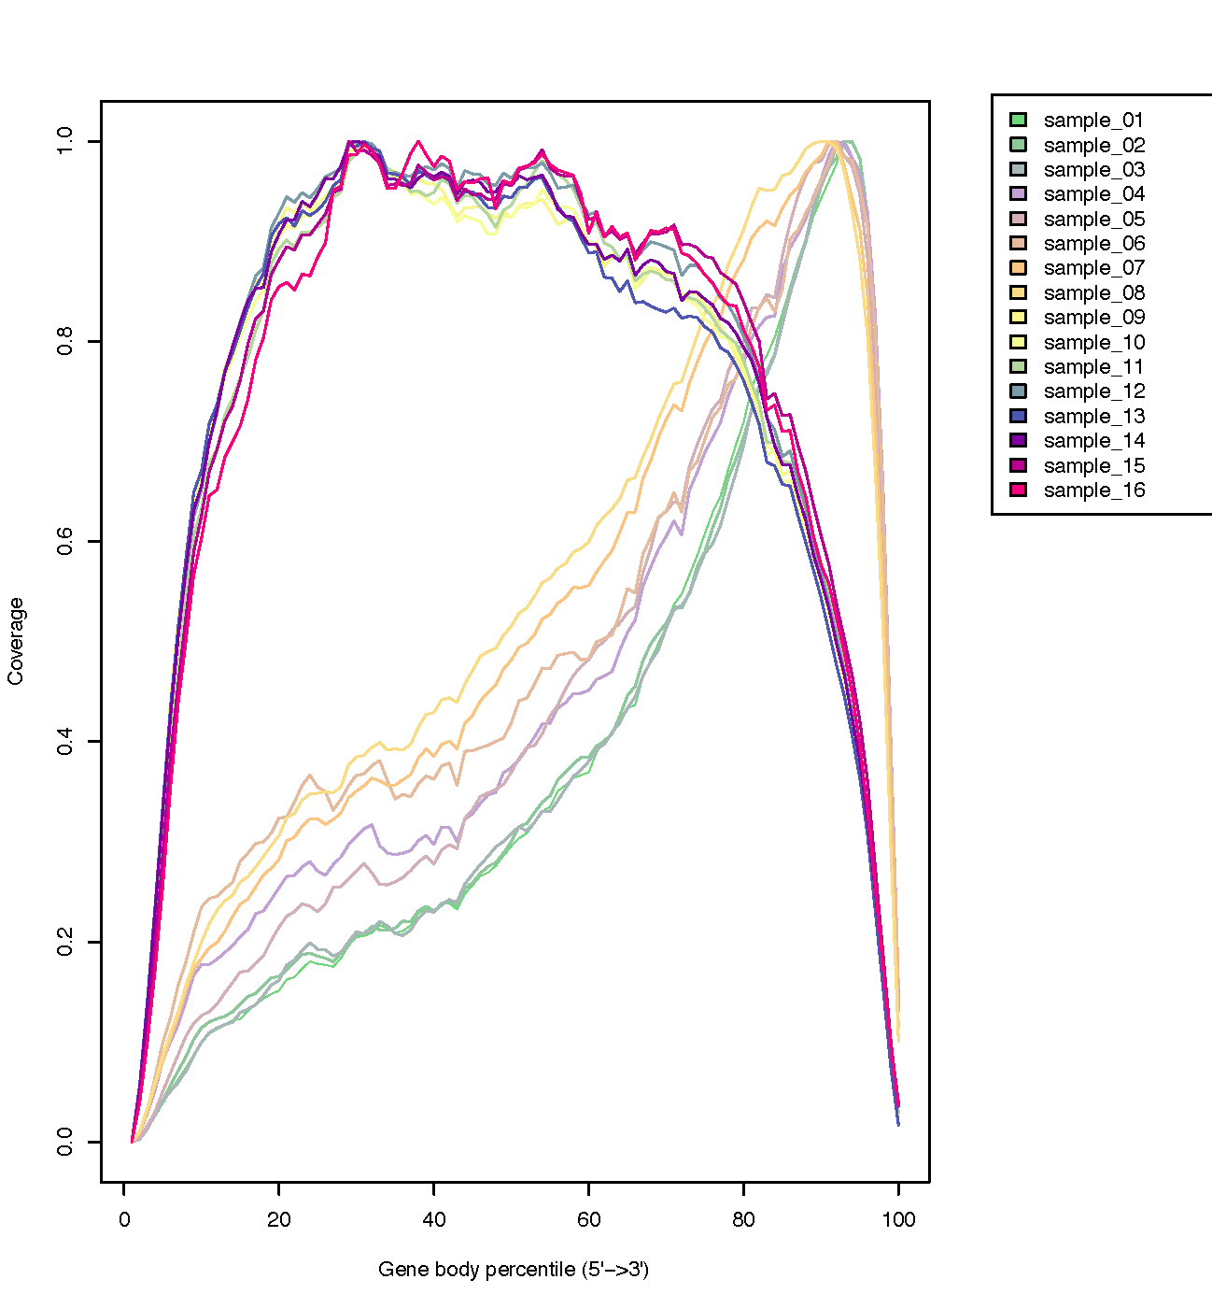
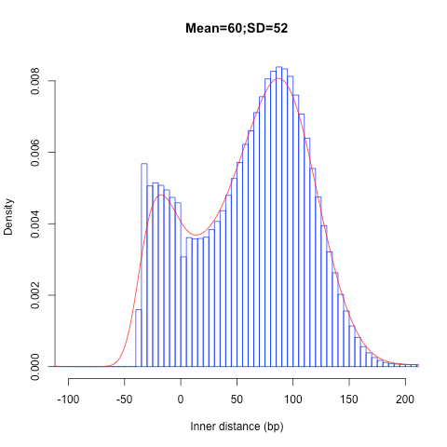
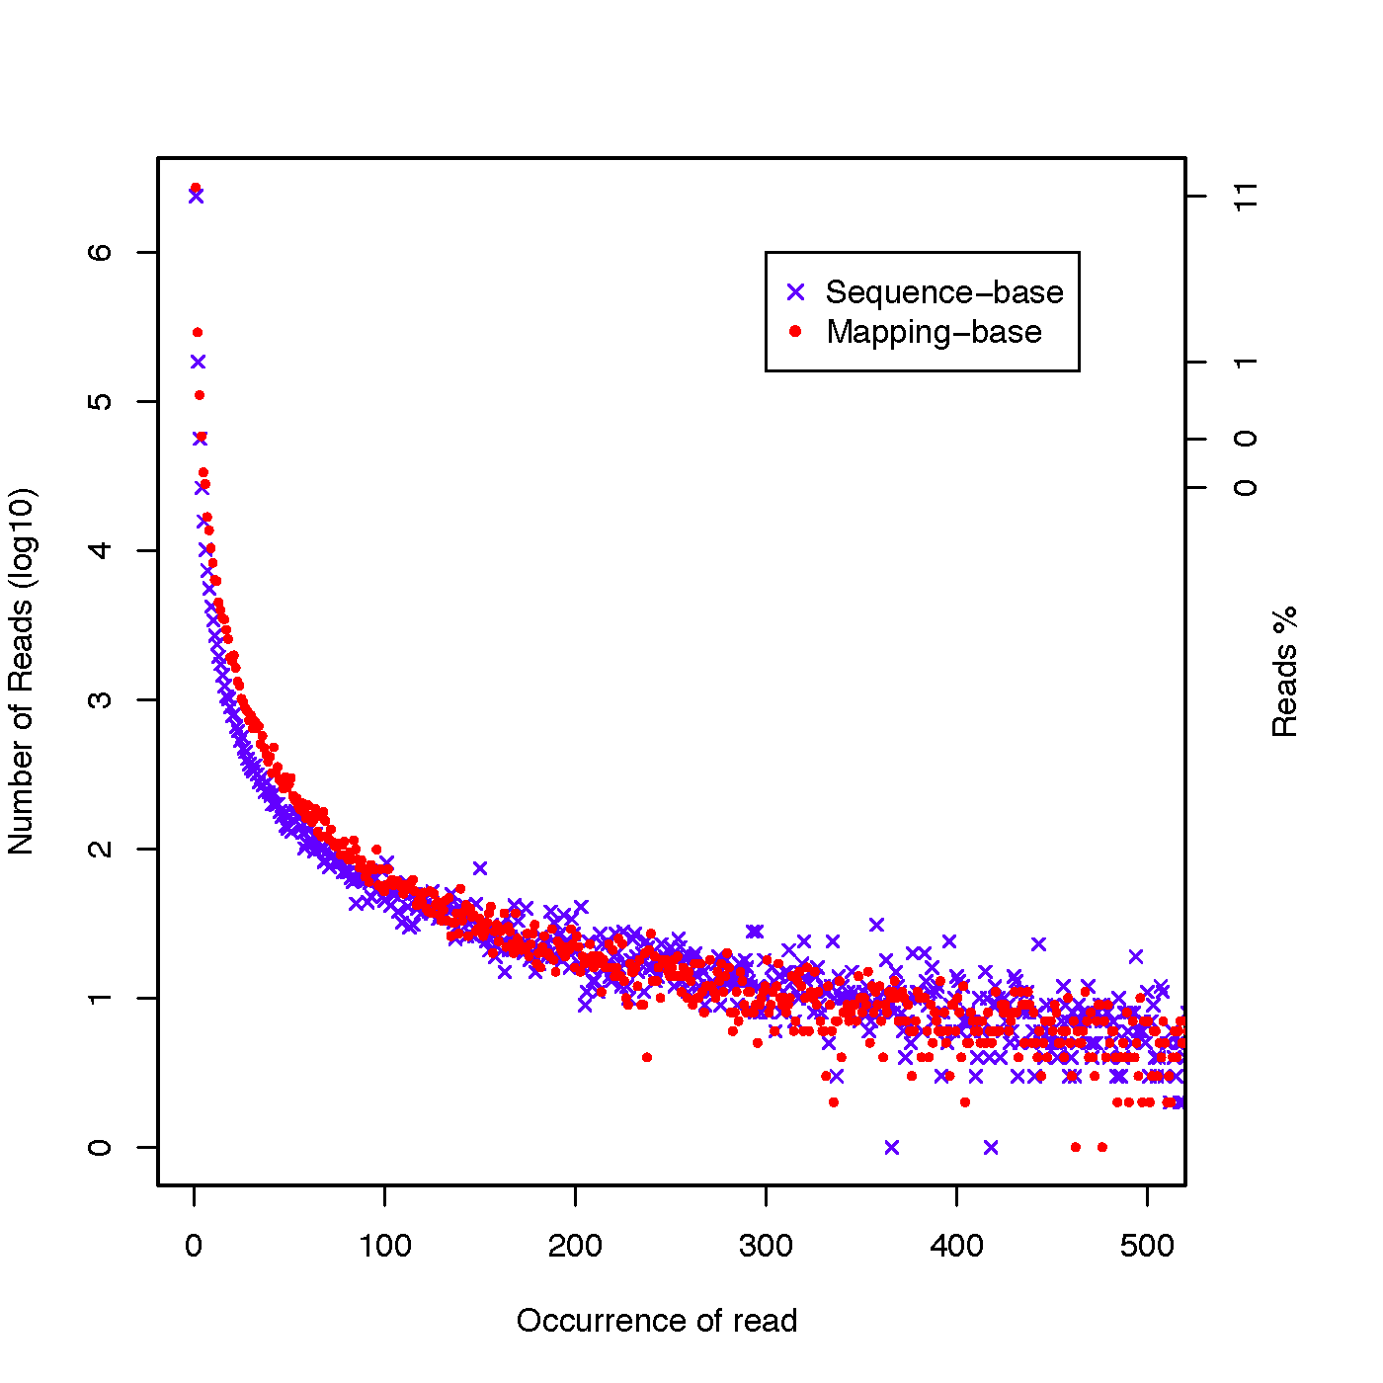
Alignment QC
Transcript coverage 3’ Bias
Insert Size
PCR Duplicates
http://rseqc.sourceforge.net
Notes:
Doing summary QC is important, you can’t check every gene manually. Things to look for in the alignment are the transcript covereage evenness. So some cloning and sequence practices end up with a three prime bias in the alignment.
In this top left picture the x-axis is basically the distance across a transcript, the y axis is the read coverage, and you can see a clear bias in some transcripts for the 3 prime end – which can interfere with quantification downstream and the quality of assembly at the 5 prime.
In the top right, you can see the distribution of the mapped distance between the pairs of the reads, this is important since a too great or too small distance after mapping indicates a bad alignment of those reads – assuming the reference genome is correct!
And the bottom picture the x-axis shows the number of times a sequence appears – that is reads with identical sequence appear. So most reads appear a few times but some appear lots and lots. Often this can be due to a sequence being really abundant because of high expression levels, but also this can be an artefact caused by PCR amplification of the same sequence, so you need to keep this in mind and inspect at least a few of the highly expressed sequences manually and be prepared to go back and make changes.
These plots and analyses all come from the same program specifically designed for assessing your alignments – a program called reqc .

Slide 54
Complete de novo – no reference
Trinity
https://github.com/trinityrnaseq
Notes:
If you really don’t have a reference sequence and want to assemble the transcripts from the reads its possible to do that. TopHat and its companion Cufflinks can do that and also Trinity is a very popular and effective system for that. Basically these programs forego the alignment and instead try to build contigs by overlapping the reads as much as they can.
Then they try to assign reads back to individual contigs and sections of the overlap graph to make a rough map of paths that can be walked through to create hypothetical transcript models.
Again, like alignment and genome assembly these models are usually considered draft assemblies and need to be QC’d for integrity

Slide 55
Assembly QC
TransRate
Notes:
And one good program for doing this is TransRate
TransRate works by identifying a set of common errors in de novo or alignment based transcriptome assembly, and this figure shows how they can be detected using read mapping data.
Family collapse occurs when members of a gene family are assembled into a single contig. This can be detected by measuring how well the nucleotides in the contig are supported by the mapped reads.
Chimerism occurs when two or more transcripts are concatenated together in a single contig during assembly. This can be detected when the expression levels of the transcripts differ, leading to a change-point in the read coverage along the contig.
Bad insertions can be detected as bases in a contig that are unsupported by the read evidence.
Incompleteness can be detected when reads or fragments align off the end of the contig.
Fragmentation is caused by low coverage and is detectable when read pairs bridge two contigs.
Local misassembly encompasses various structural errors that can occur during assembly, such as inversions,
These are detectable when both members of a read pair align to a single contig, but in a manner inconsistent with the sequencing protocol.
Redundancy occurs when a single transcript is represented by multiple overlapping contigs.
TransRate takes as input one or more de novo transcriptome assemblies and the paired-end reads used to generate them. (2) The reads are aligned to the contigs. And then four different score components are calculated that assess the potential problem areas.
The four score sare integrated to generate an overall score for assembly.
So TransRate is a useful way of seeing quite quickly which bits of your assemblies need to be improved and allows you to compare assemblies from different programs or settings

Slide 56
Alignments Mappings to expression
Normalize counts for expression levels –
to account for differences in gene length, read counts are converted to Reads per kilobase of transcript mapped (RPKM)
Raw count
RPKM
8
1
24
6
8
12
RPKM_{geneA} = 10⁹ C_{geneA} / NL
C_{geneA} = number of reads mapped to geneA
N = total number of reads
L = length of transcript in units of Kb
Cufflinks/CuffDiff
Trinity
Notes:
Once you’ve got the transcripts and you’re happy with them then often you will want to go on to quantify. Its quite unsual to just take the absolute number of reads
Expression is biased for gene length (longer transcripts should have more reads) to normalize, reads are converted to Reads per Kilobase of transcript per million reads mapped
Which can completely overturn the counts but gives overall a more believable number for the whole transcript set.
Several software tools available to do mapping and calculate normalized expression measurements across different samples including Most RNAseq programs like Tophat and Cufflinks and trinity will do this and statistics modules like the Bioconductor packages DESeq, and EDGER can help with calculating these values
It can often be a choice so use?
RPKM
When you want to leverage benefits of tuxedo suite
Good for visualization (e.g., heatmaps)
Calculating fold changes, etc.
Counts
More robust statistical methods for differential expression
Accommodates more sophisticated experimental designs with appropriate statistical tests
Transcript-level plots showing transcript structures and expression levels

Slide 57
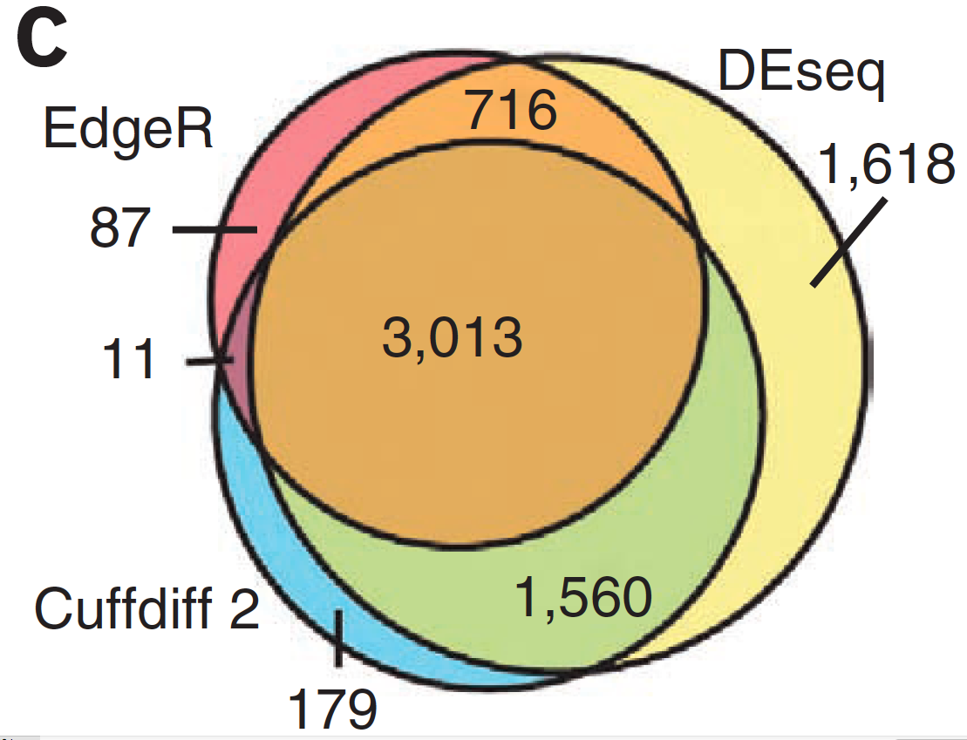
Alternative differential expression methods
Raw count approaches
DESeq - http://www-huber.embl.de/users/anders/DESeq/
edgeR - http://www.bioconductor.org/packages/release/bioc/html/edgeR.html
Notes:
Whenever you do generate differential expression methods, then you may want to try a couple of methods at least,
as they aren’t all equally sensitive or specific. So this figure shows the overlaps between differential expression calls from various methods and there are clearly some genes that only one or two methods picks up and that might be important to your study

Slide 58
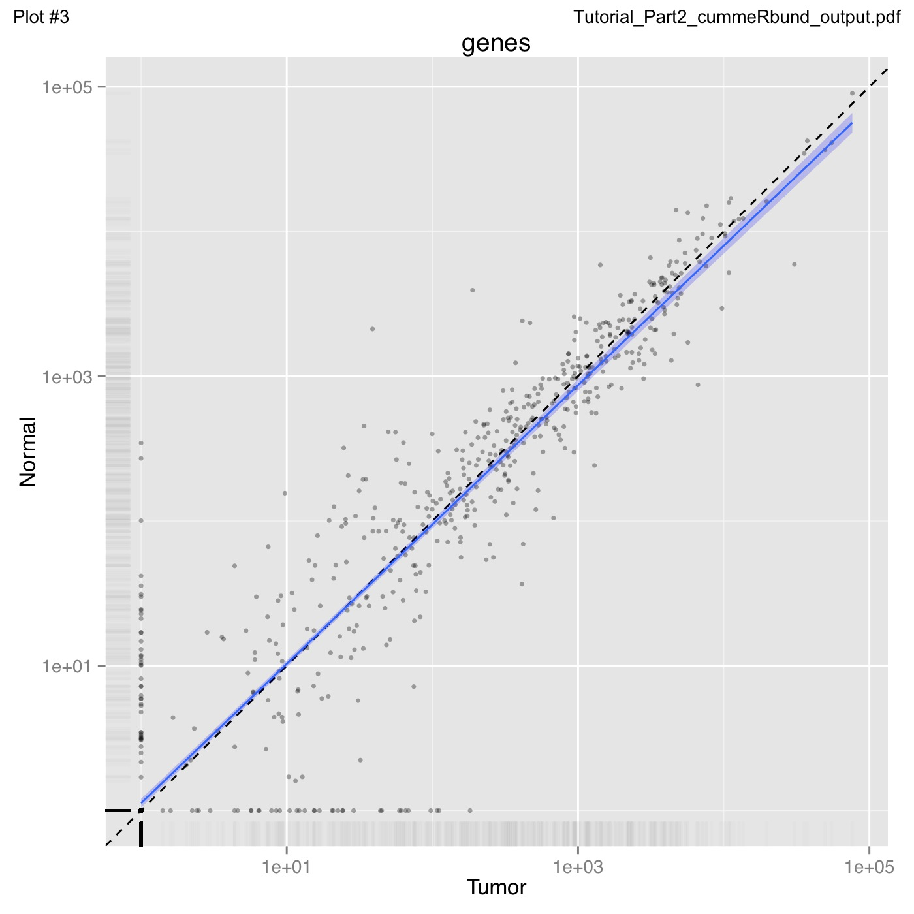
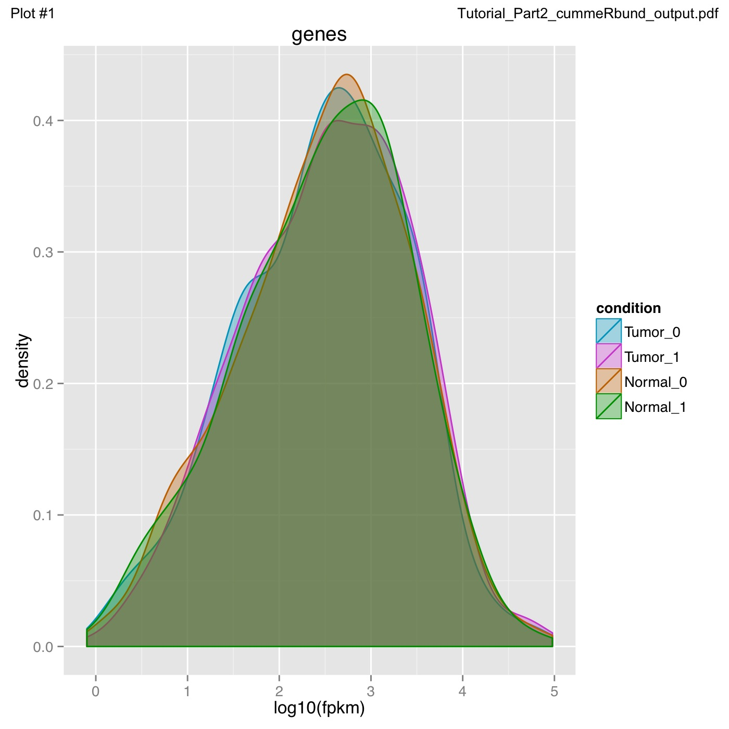
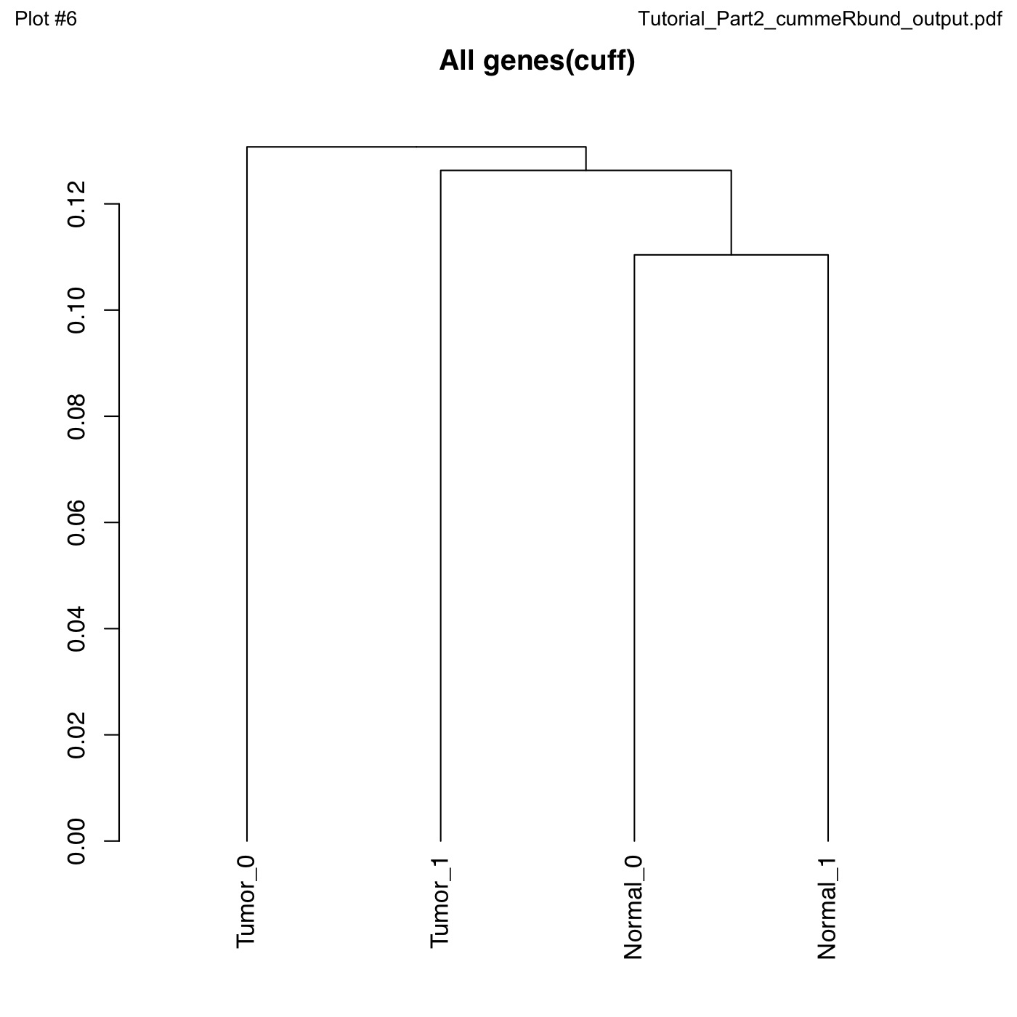
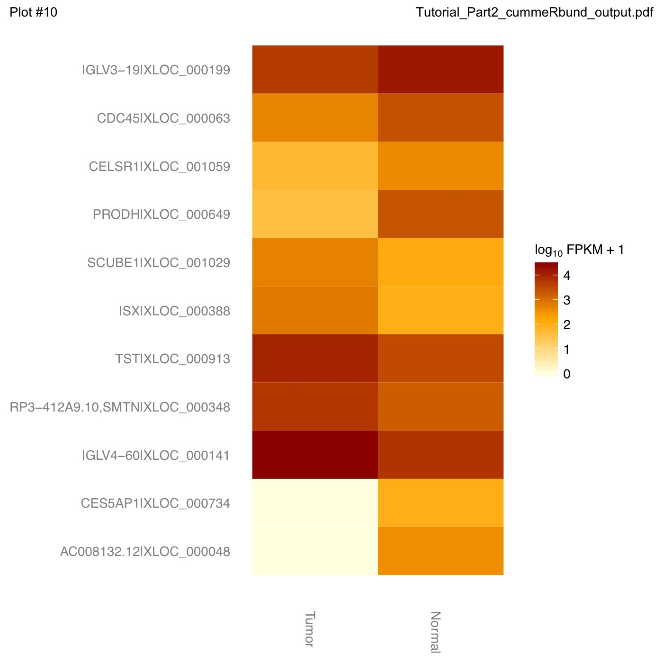
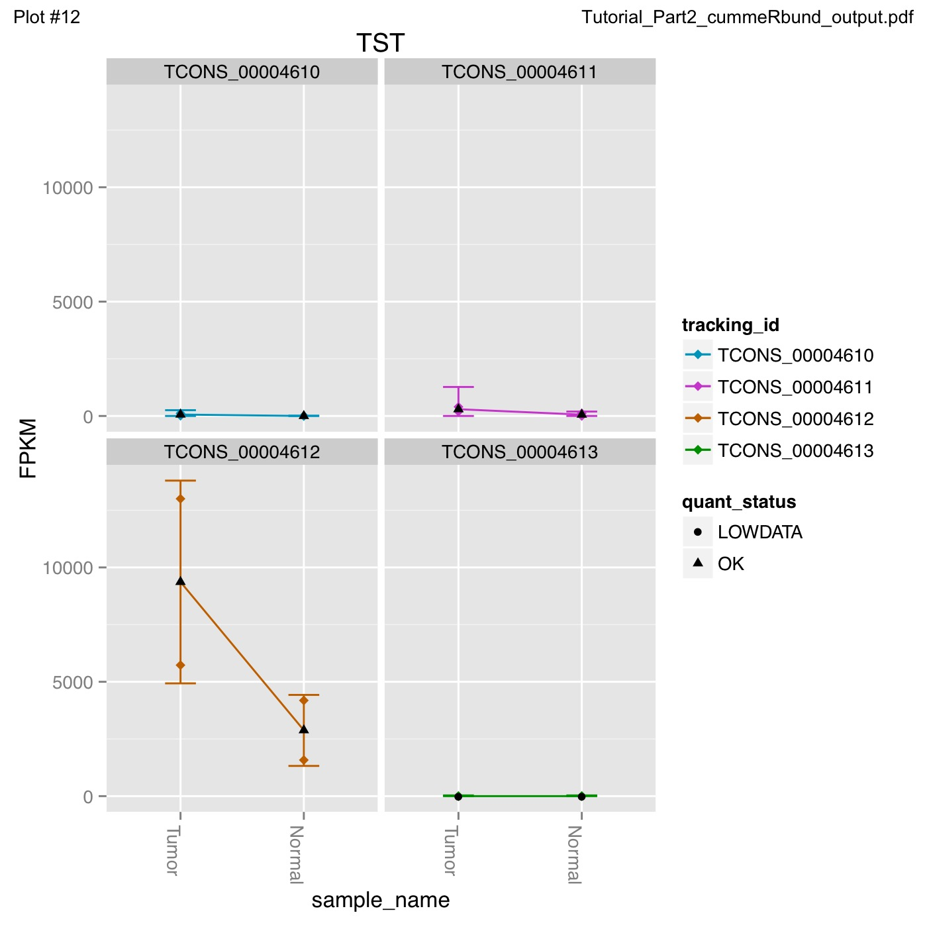
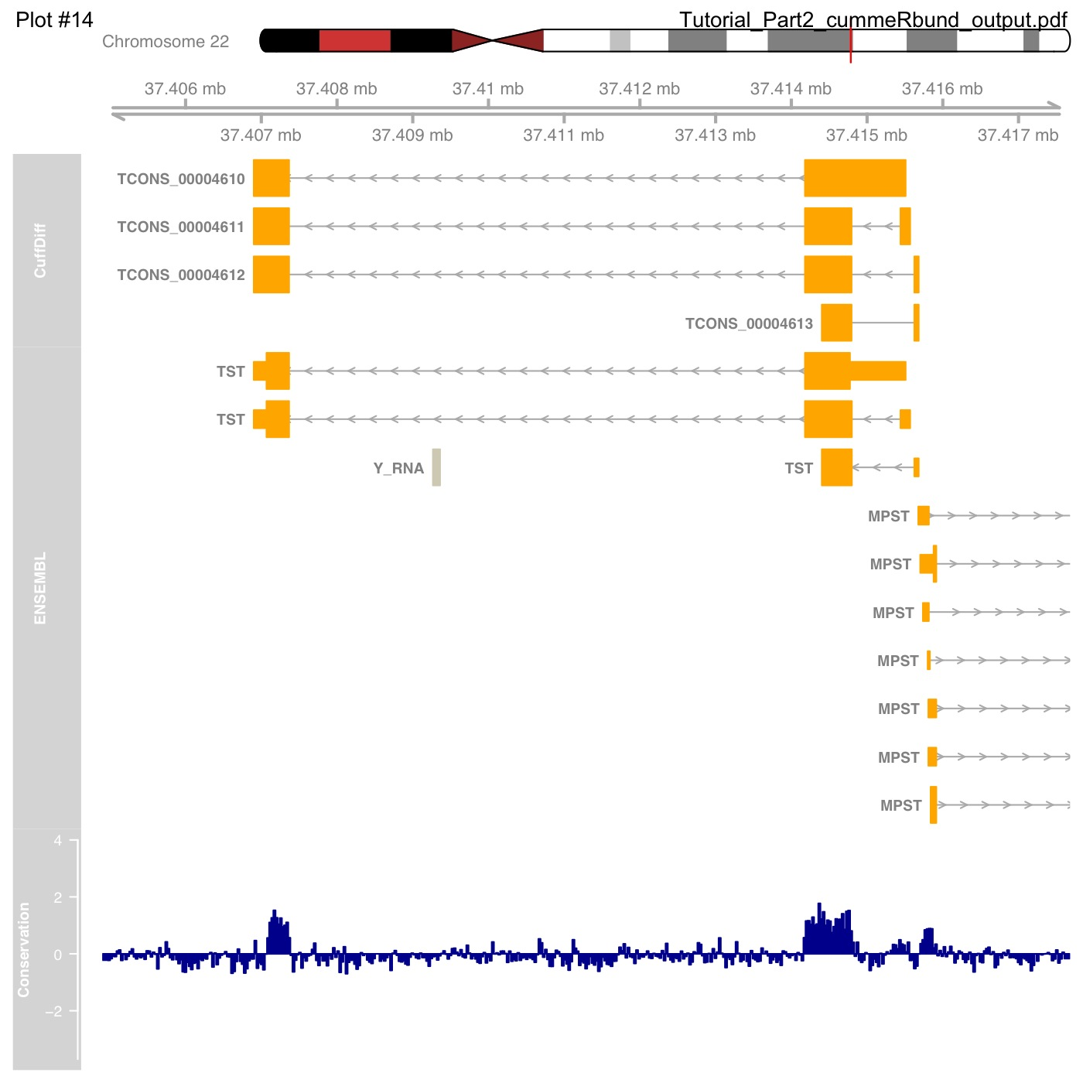
cummeRbund
Analysis of expression in R
Notes:
Once you’ve generated the expression values, then its necessary to visualise them and create summary and even individual gene plots. This is best done in interactive statistical packages like the R package cummeRbund, which can do a lot of heavy lifting for you, at the expense of you needing to know a little bit of R programming.
Cummerbund Automatically generates many of the commonly used data visualizations
Distribution plots
Overall correlations plots
MA plots
Volcano plots
Clustering, PCA and MDS plots to assess global relationships between conditions
Heatmaps
Gene trees

Slide 59
Which tool? Which experimental design?
False/True Positive Rate at different fold changes and replicate numbers
Fold Change Cutoff
0
0.5
2.0
Tool
Samples
Schurch et al
http://arxiv.org/pdf/1505.02017v2.pdf
Notes:
Ok so finally I want to mention the issue of replicates, This study of statistical power of differential expression detection looks at the true positive and false positive rate at different numbers of samples sequenced. So the rows are 3,6 12 and 20 samples sequenced and the columns are increasing fold change cutoffs applied.
And we can see from this that at the lower number of replicates the true positive rate is reduced by around ten percent for most tools studied, so you get a real reduction in power from doing the standard just 3 replicates. And it gets worse if you want to try and spot smaller differences in expression.

Slide 60
Which tool? Which experimental design?
At least six replicates per condition for all experiments.
At least 12 replicates per condition for experiments where identifying the majority of all DE genes is important.
For experiments with <12 replicates per condition; use edgeR(exact).
For experiments with >12 replicates per condition; useDESeq.
Apply a fold-change threshold appropriate to the number of replicates per condition between 0.1 ≤ T ≤ 0.5.
Schurch et al
http://arxiv.org/pdf/1505.02017v2.pdf
Notes:
And the paper is worth taking a close look at if you are designing the experiment since it makes some pretty strong recommendations about tool choice relative to experimental design, including stating you should use at least 6 replicates for all experiments.
Obviously this will in the real world be tempered by what funds are available but it is food for thought and if you do need to get close to the all differentially expressed genes then you absolutely do need more than the minimum three replicates.

Slide 61
Metagenomics
Best Practices, Best Tools
Notes:
So for this next section Im going to go through some approaches in metagenomics, and this is in some ways the most convoluted of the different ’omics approaches we’ve looked at today, because its often many approaches under on umbrella.

Slide 62
Structure
AIM:
Help you understand strategies used in metagenomics experiment
Experimental Aims
Pipelines and Tools
Metagenome Taxonomy
Metagenome Function
Metatranscriptomes
Notes:
And the main aim will be to give you again, the 1000 mile up view – to help you understand the strategies used in metagenomics experiments
Particularly the experimental aims and pipelines people use as they apply to the three main domains in metagenomics, the Taxonomical classification, Functional classification and the use of transcriptomics approaches

Slide 63
What is metagenomics?
Environmental genomics
Samples of mixed genomes, from some place
Microbiomes
e.g genomes of microbes in soil samples
Plant Pathogen Infection
e.g field pathogenomics
Not so much marker gene surveys
eg. 16S
Effective way to profile structure and function of communities
Notes:
So its probably a good idea to come up with a working definition of metagenomics – Metagenomics as a word is a bit of a poor choice, it doesn’t express much in itself and its used loosely sometimes. I think a good way to think of it is as Environmental Genomics. As a way of looking at samples with lots of mixed up genomes from some place.
This is in contrast then to the normal genomics in which we sequence just one thing, like a plant or a cultured micro-organism.
And the main sort of metagenomes we tend to think of are those come from microbiomes so a soil sample, but also sequencing disease infected plant tissue in infection studies or in field pathogenomcs is a set of mixed up genomes, so you can think of that as metagenomics too.
Before NGS people used to use select genes rather than whole genomes, such as 16S rRNA genes, with NGS people still do this on a wider scale, but there are some voices out there that will shout – this isn’t metagenomics – but I will cover a little bit about those approaches

Slide 64
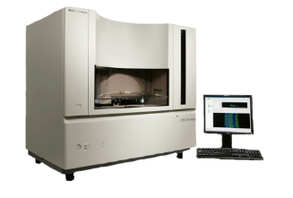
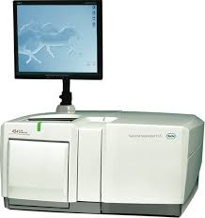
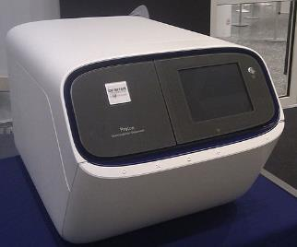
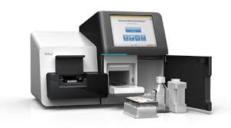
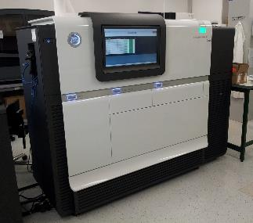
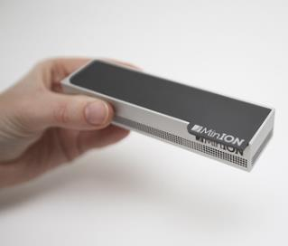
Metagenomics Sequencing
Roche 454
Sanger
Ion Torrent
Nanopore
Illumina *Seq
Pacific Biosciences
Notes:
Ok, the sort of sequencing that gets used is nowadays mostly the Illumina and PacBio sequence, marker gene studies in the past used the familiar Sanger and some earlier deep metagenomics studies used 454 which is a somewhat outdated medium throughput, short length sequencing, and you’ll
Most use Illumina now though its expected that the nanopore - which is a tiny handheld sequencer will become more used in the field in the coming years.

Slide 65
Data Quality Issues
Sequencing errors
Error rates, error type (PacBio: 10% random, Illumina – 0.1% substitution)
Chimeras
Amplification artifacts, cloning of restriction fragments
Notes:
The first step after you get your sequence – whatever you’re going to do with it ultimately– is preprocess and try to ensure data quality.
Sequence data isn’t 100 percent accurate, in fact each base comes with an associated probability of being wrong – and you can use that to improve the integrity of the data as a whole.
Different types of sequence data have different rates and patterns – PacBio has a huge 10% error rate at its worst– but theyre random errors without any systematic bias, Illumina has a 0.1% errors which are mostly substitutions.
There are errors that come from other steps in the pipelines, so the cloning and amplification steps can introduce molecules and sequences that aren’t present in vivo but can seem quite abundant and real in the data downstream and these have to be avoided.

Slide 66
Metagenomics approaches - Summary
Who’s There?
What Are They Doing?
How much are they doing it?
Functional
Annotation
RNASeq
Marker Gene
Taxonomic Binning
Assembly
Expression
Notes:
Right so when we have good sequence we can start to analyse it .
There are basically three questions we’d want to ask in metagenomics.
Firstly, who’s there – which organisms are in the sample. And these pipelines usually start off with some sort of taxonomic classification of reads, though assembly of reads can help improve specificity of that.
Then there’s What are they doing – which tries to use databases to work out what biochemcial pathways are prevalent in those organisms, again this sort of annotation can be improved by assembling sequences first
And there’s also – How much are they doing it – this is an RNASeq based metatranscriptomics piepline that like functional annotation can be improved by assembly and even by separating the reads into different clades before assemlby and creating gene expression estimates.
And I’ll go through each of these individually.

Slide 67
Metagenome Taxonomy
Who’s there?
Extract DNA
Sequence random fragments
QC
Diversity analysis
Notes:
So here’s the basic pipeline for a metagenome taxonomy experiment, its really quit brief, you get your DNA, you sequence it, you do QC and head to diversity analysis,
But even when you’ve got a really good set of sequence data, you still have some potential pitfalls in the nature of the data itself.

Slide 68
Metagenome Taxonomy
Who’s there?
Goal: Identify the relative abundance of different microbes in a sample
Problems:
Reads are all mixed together
Reads can be short (~100bp)
Two broad approaches
Binning Based
Marker Based
Notes:
The biggest problem is that of course, all the reads are mixed together regardless of what species they come from. Depending on the sequence type then the reads can be short and short reads are harder to specifically pin down to a particular origin.
The two main approaches are the binning based or marker based approaches.

Slide 69
Binning Methods
Attempts to “bin” reads into the genome from which they originated
Composition-based
Uses GC composition or k-mers (e.g. Naïve Bayes Classifier)
Generally not very precise and not recommended
Sequence-based
Compare reads to large reference database using BLAST (or some other similarity search method)
Reads are assigned based on “Best-hit” or “Lowest Common Ancestor” approach
Notes:
A binning method is basically a technique that tries to group each read with all the others from the same genome.
Some studies out their have used stuff like GC composition of reads to create bins, though this is pretty poor when it comes to bein accurate about what the actual species is
Much more powerful are the sequence based methods that use databases of sequence of known origin as a reference and basically blast the sequence against that. The idea is that the best hit in the database or more often the lowest common ancestor between hits is the proper taxonomic classification.
Although I say blast, really it isn’t blast that gets used – its too slow - but some sort of similarity search method

Slide 70
Binning Tools
Notable Examples:
MEGAN: http://ab.inf.uni-tuebingen.de/software/megan6/
One of the first metagenomic tools
Does functional profiling
Notes:
Software that implements this easily are quite abundant, the best and most famous is probably MEGAN, now on version six, which does an awful lot of stuff incuding functional annotation, can handle lots of file formats and different taxonomies.
It also produces end result visualisations like bar charts and word clouds and will generate some statistics. It doesn’t do similarity searches directly but can work with a companion package called diamond that does.
And it’s major advantage to a beginner is that it has a graphical interface to work with

Slide 71

Binning Tools
Notable Examples:
Kraken: https://ccb.jhu.edu/software/kraken/
Fastest binning approach to date and very accurate.
Large computing requirements (e.g. >128GB RAM)
Notes:
The most powerful and most accurate tool at the moment is a command line driven tool. Its called Kraken and it works in timescales of minutes to hours by use of a clever algorithm for similarity search. Its actually fairly straightforward to use but it can have huge memory use in some steps, especially if you’re looking to create custom taxonomic databases. The authors do provide some pre-compiled databases so if you don’t have special requirements then you might have an easier time. The

Slide 72
Marker Methods
Single Gene
Identify and extract reads hitting a single marker gene (e.g. 16S, cpn60, or other “universal” genes)
Use existing bioinformatics pipeline (e.g. QIIME.)
Multiple Gene
Several universal genes
PhyloSift Uses 37 universal single-copy genes
Notes:
Ok, so briefly about Marker based methods, these work either by identifying known universal genes, like the 16S rRNA and there are tool for this, like QIIME.
Some others use multiple supposedly universal single copy genes – so you have to make a call as to whether you really think the genes selected are useful and discriminatory, these are mostly useful for microorganism metagenomics and don’t handle plant tissue so well.

Slide 73
‘left-over’ Reads
What about the reads that can’t be classified?
Errors?
Novel Sequence?
Just not in database?
Try assembling the left-overs
Notes:
So what if you do a binning experiment but not all the reads can be binned? This isnt just because the reads are wrong, the database may lack sequences matching yours because its novel are divergent or the db isn’t wide enough.
You can always try assembling the leftovers,

Slide 74
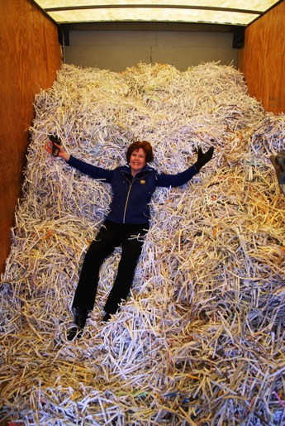
Metagenomic assembly
Notes:
In single genome genomics the assembly problem is often likened to putting back together a book after it has been shredded.
Well in metagenomics, it is far more difficult, its more like putting a bookshelf back together after shredding soif you are going to do assembly then you need to be aware of the problem of chimeric contigs – bits of the assembly that arent real and are the result of fusion of similar sequences from different organisms

Slide 75
Metagenomic assembly
Specific assemblers
IDBA-UD,
Meta-IDBA,
Meta-Velvet,
Ray Meta,
Meta-Cortex
Validation
LAP,
ALE,
QUAST,
FRCbam,
REAPR
Analysis Pipelines
MetAMOS
Notes:
And some specific metagenome assemblers have been developed, including variants of some standard assemblers, the important thing is to assess the quality of assemblies and there are correspondingly lots of programs for this.
Thankfully, as this is a hard problem then these tools have been wrapped into pipelines, a pipeline called MetAMOS will allow you to run all of these tools at various settings and assess the results in one overarching wrapper. MetAMOS produces plots, classifications and sequence metrics as well as being compatible with assembly visulaisation tools like hawkeye.

Slide 76
What do we mean by function?
Metagenome Function
What are they doing?
General categories
Photosynthesis
Nitrogen metabolism
Glycolysis
Specific groups of orthologs
EC: 1.1.1.1 (alchohol dehydrogenase)
K00929 (butyrate kinase)
Notes:
So the next question, once we know what is in our sample can often be, what are they doing – basically this is what genes do they have, is there anything community specific in there.
And this means putting an annotation onto the genes or sequences that we have. This can be a general fairly high level sort of categoric annotation such as saying the gene is involved in photosynthesis or nitrogen metabolism. But also its often useful to get much more granular annotation, so identifying orthologs and individual enzyme functions. So what you end up with is for each sequence, a list of technical terms that describe what it does, and you can analyse those lists to test hypotheses about whats your metagenome does.

Slide 77
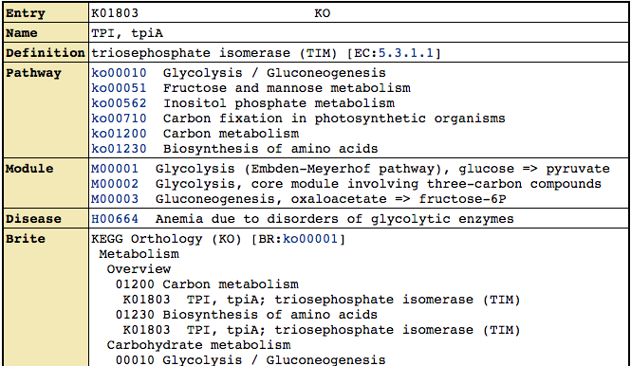
KEGG for functional annotation
KEGG Orthologs (KOs) http://www.genome.jp/kegg/ko.html
Most specific. Thought to be homologs and doing the same exact “function”
~12,000 KOs in the database
These can be linked into KEGG Modules and KEGG Pathways,
Identifiers: K01803, K00231, etc.
Notes:
One extremely popular database for annotation is the KEGG database, which holds a collection of orthologs across species thought to be doing the same function so useable across species. They’re simple annotations like this one and have a K-number identifier

Slide 78
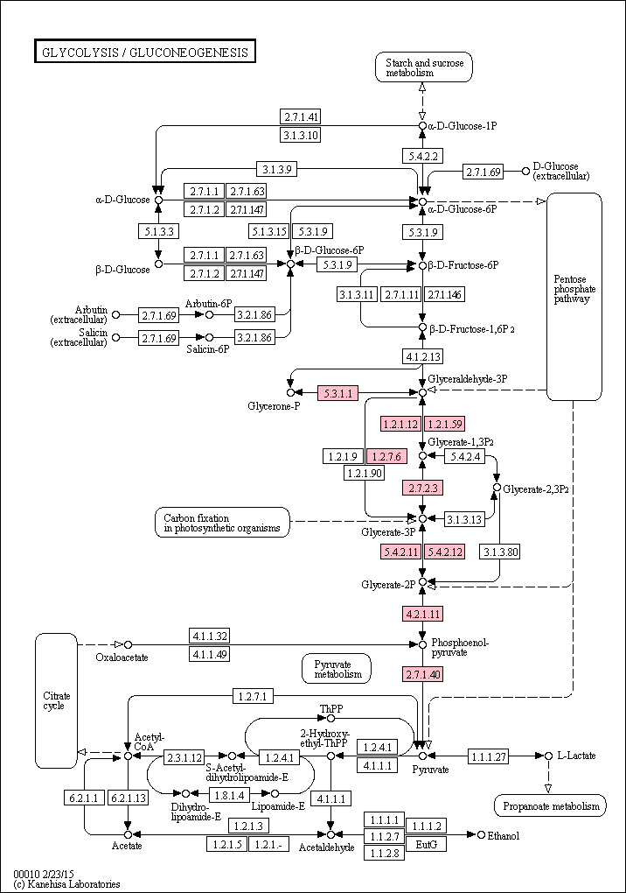
KEGG for functional annotation
KEGG Pathways
Groups KOs into large pathways (~230)
Each pathway has a graphical map
Individual KOs or Modules can be highlighted within these maps
Pathways can be collapsed into very general functional terms (e.g. Amino Acid Metabolism, Carbohydrate Metabolism, etc.)
Notes:
Kegg is most powerful because it groups its orthologs into large metabolic pathways for high-level functions and each as map like this so its possible to illuminate pathways that are present

Slide 79
Metagenomic Annotation tools
Web-based
EBI Metagenomics Server
MG-RAST
IMG/M
Koala
GUI-Based
MEGAN
Allows connection between taxonomy and function
ClovR
Virtual Machine based - microbial
Local-based
Prokka
MetAMOS
Built in assembly, highly customizable,
DIY
Set up your own in-house custom computational pipeline
Notes:
And again annotation of sequences is done by a large number of tools, heres some online ones, Koala is the KEGG tool. There’s also a couple of GUI ones including megan that I mentioned earlier, and a couple of locally run ones, prokka is ideal and fast for prokaryotes and MetAMOS as we’ve discussed wraps an awful lot of other tools for a quite comprehensive annotation.
That said though, these tools don’t find everything, often there are classes of genes that are specific to a particular community, for example effector proteins and R genes in the plant disease field. These won’t get annotated specifically as such by any of these tools so there often needs to be custom parts of the pipeline to catch and annotate the genes you are interested in yourself. So you might run a filter to find a gene with transmembrance domains, signal peptides, LRRs etc and classify this accordingly.

Slide 80
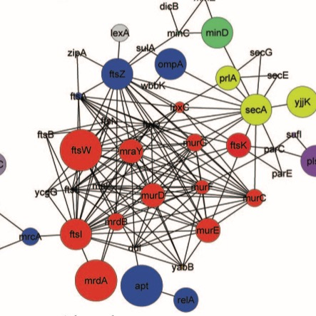
Metatranscriptomics for community activity
Functional Quantification
Use RNA-Seq to determine which genes and pathways are being actively expressed within a community
Genes involved in pathways associated with cell wall biogenesis
Relative abundance of transcripts
Relative abundance and contributing taxa
Notes:
So moving on from identifying what functions are there, it is possible to use RNAseq in metatranscriptomics to reveal which genes are active at a given time and in combination with the
Taxonomical approaches it can also reveal which taxa are responsible for the active functions, giving a large amount of deep information about what is going on in a microbiome or interaction. So in these graphs we can see the circles are genes and the size of the circle is the abundance of those transcripts and the areas on the Pie charts show the taxa that are contributing to the transcript abundance.

Slide 81
Metatranscriptomics: Assembling to annotate
contig1
contig2
Notes:
Again this approach is facilitated by assembly,
First of all assembly is different with transcriptomics data because of the highly variable coverage of each sequence due to transcript abundance and the increased likelihood of chimeras from reduced sequence space, and problems generated by transcript isoforms, so transcriptome assemblers are useful and these Including cufflinks, Oases and trinity.
Taxonomic binning prior to assembly can assist by grouping reads into species specific bins.
But once you have an assembly, it again improves annotation accuracy, This graph shows a heatmap of different assemblers and paramaters and the proportion of contigs annotated with a known gene at different contig lengths. As the contig length grows then the proportion of contigs with a recognisable gene in there increases.
Trinity appears to provide best performance in terms of reads that can be annotated from this study, but each dataset will be different and again optimisation and validation will be crucial to getting a good solid answer.

Slide 82
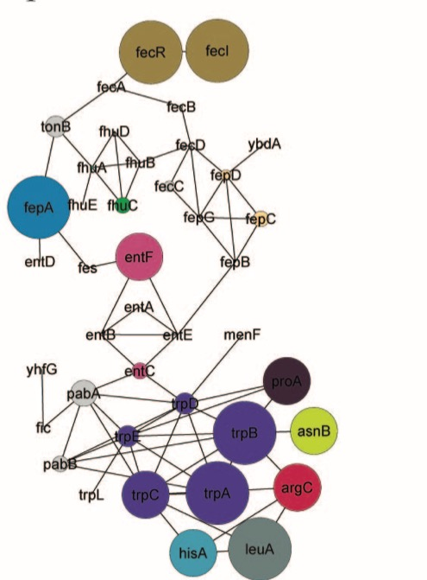
Metatranscriptomics: Understanding results
How do we identify those systems which are differentially regulated across samples (e.g. systems up-regulated in disease vrs. health)?
Gene Set Enrichment Analysis
- Node Size = number genes with an annotation
Network analysis
– genes with related function and similar
changes in expression
Notes:
Once you’ve got the values then you’ll likely start to compare systems across samples
Does need robust statistics – and that’s a training day in itself so I won’t touch on it. but as a prelimiinary visualising is very helpful
A technique calledd Gene set enrichment analysis (GSEA) gathers discrete groups of functionally related genes and can say whether they are more apparent in the set than otherwise
GSEA may define trpA-E
as a single group of
related genes, but group
as a whole may not be
significantly upregulated
An alternative and more involved network approach can identify groups of genes based on functional interactions AND their differential expression to identify pathways rather than prescribed gene sets.

Slide 83
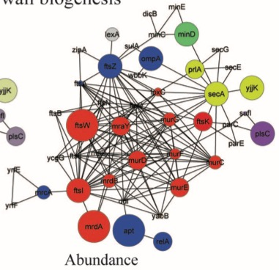
Metatranscriptomics: Understanding results
Cytoscape
www.cytoscape.org
MeV
www.tm4.org/mev.html
R
D3.js
Genes involved in pathways associated with cell wall biogenesis
Relative abundance
Relative abundance and contributing taxa
Notes:
And this can be done in GUI based programs like Cytoscape which allows drawing of networks and the mapping of dimensions of data on top, like this arabidopsis gene activity network
In addition to representing protein interaction or metabolic relationships through network visualization, Cytoscape offers the ability to represent nodes (proteins) as pie charts or donuts, allowing the visualization of taxonomic contributions to discrete functions – the graph I showed you earlier is a cytoscape one.
For those of you who want to program your visualisation, R has a lot of useful functions for this, and libraries like the javascript d3 library are extremely powerful, if a little opaque.

